Slide 1
Design And Analysis of Algorithms
Isomorphism in biological networks
BY:
N.Sowgna-2010030344
E.Pravallika-2010030046
Tahseen Begum-2010030168
Keerthana-2010030445
Under the guidance of
P. Sree Lakshmi

Slide 2
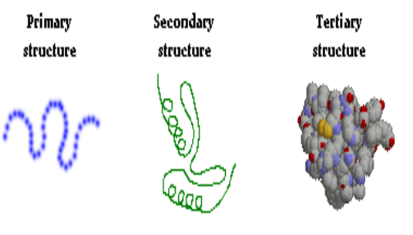
Problem Statement
Graph Isomorphism Is Widely Used In Various Applications Such As Image Processing, Protein Structure, Computer And Information System, Chemical Bond Structure, Social Networks.
We Use Protein Structure ,Nodes Represents Protein And Edges Represents Their Interactions Between Nodes.
We Have Three Levels Of Protein Structure I.E. , Primary Structure ,Secondary Structure , Tertiary Structure.
For Example Collection Of Food Is Available And Every Food Is Having Their Own Structure That Is Graph Structure. For Providing The Food And That Food Contains Some Proteins, Then Find Protein Graph Structure First And Check Where It Is Available In The Food Structure Or Not.

Slide 3
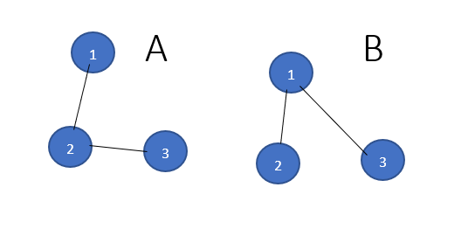
Algorithm used- its description- Numeric example
We have Graph A and B , now we have to check the two graph are isomorphic are not using VF2 Algorithm
Our vertex are 1,2,3,4 in graph A and B

Slide 4
Step 1 :
I match empty A with empty B it always works.
We can match 1A with 1B,2B,3B
Now we take 1A with 1B it always works
Step 2 :
I can match 2A with 2B or 3B
I match 2V with 2B always works because 1A,2A and 1B,2B are connected.
Step 3 :
I can match 3A with any node in Graph B we cannot connect because there is no edge between 2B and 3B in graph B , so we will go back to again step2.
Step 4:
I can match with 2A with 3B we cannot connect because there is no edge between 2B and 3B in graph B , so we will go back to again step2,But in step2 we didn’t have solution , so we will go to step1.
Step 5:
I match 1A with 2B and 2A with 1B and 3A with 3B
The graphs are isomorphic

Slide 5
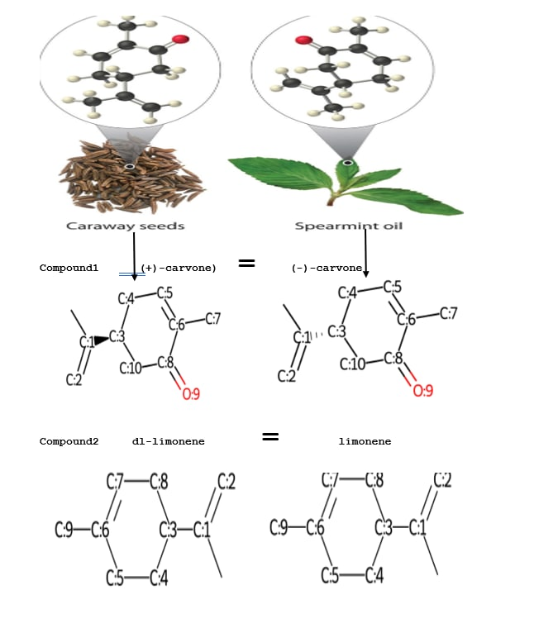
Flow chart of the proposed solution

Slide 6
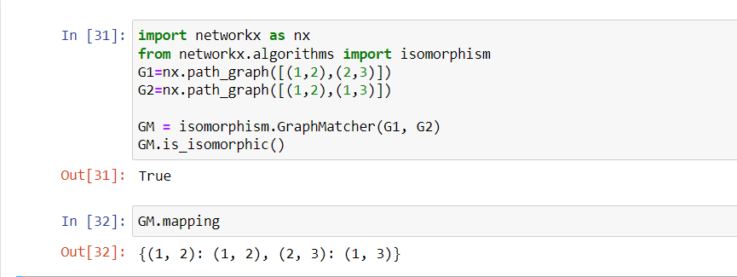
Numeric example of the algorithm (Sample input - expected output)
An implementation of VF2 algorithm for graph isomorphism testing.The simplest interface to is to call networkx.is_isomorphic().

Slide 7

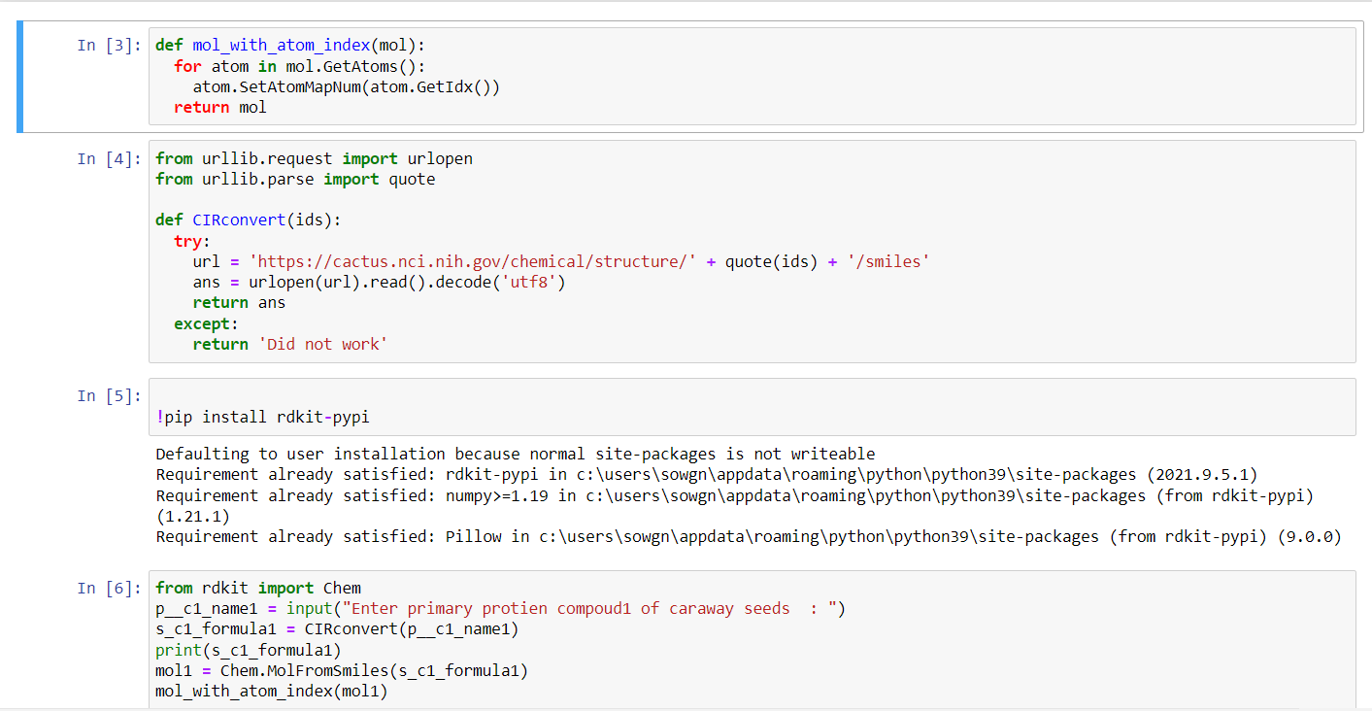
Coding status and testing

Slide 8
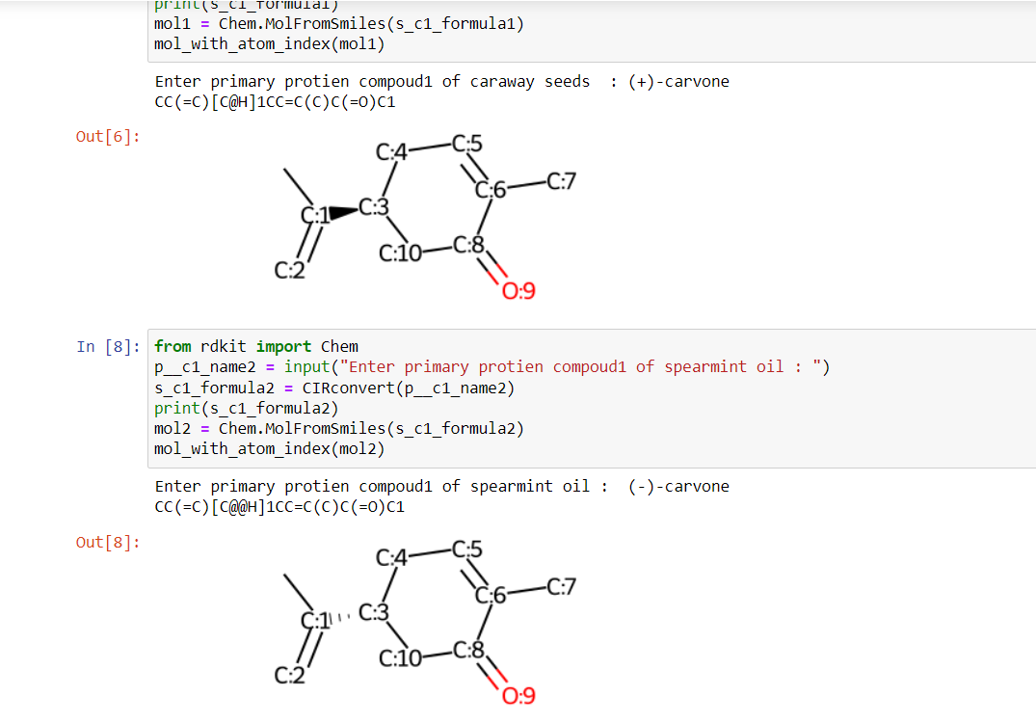

Slide 9
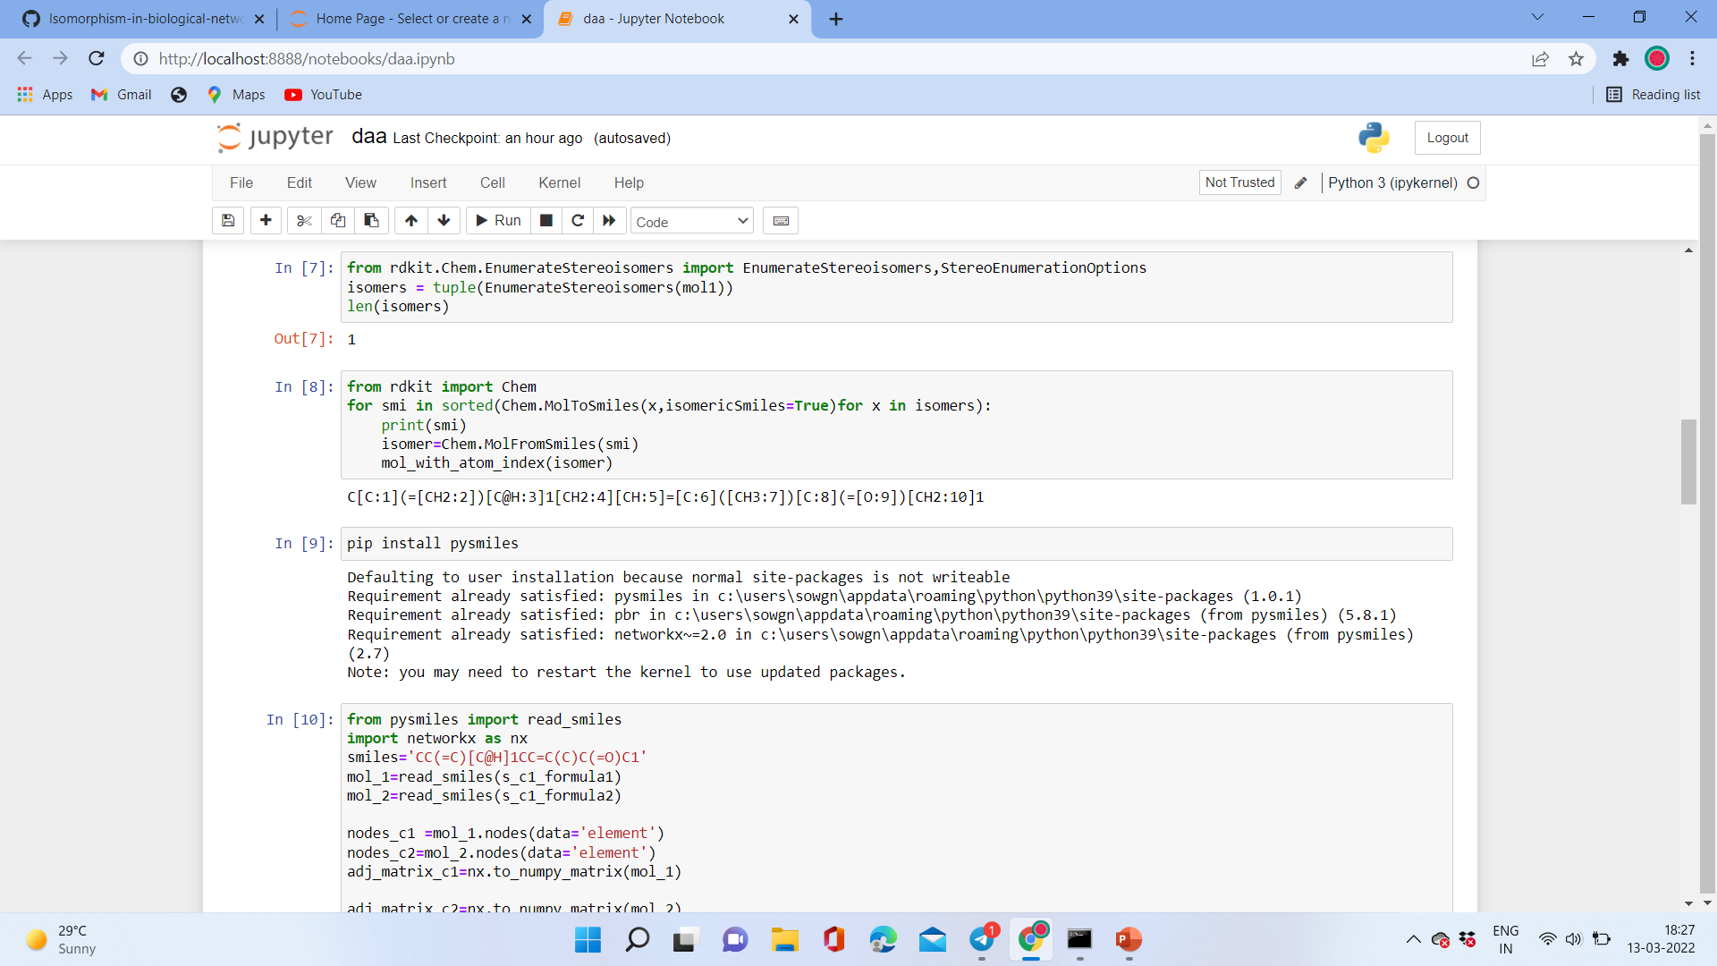

Slide 10
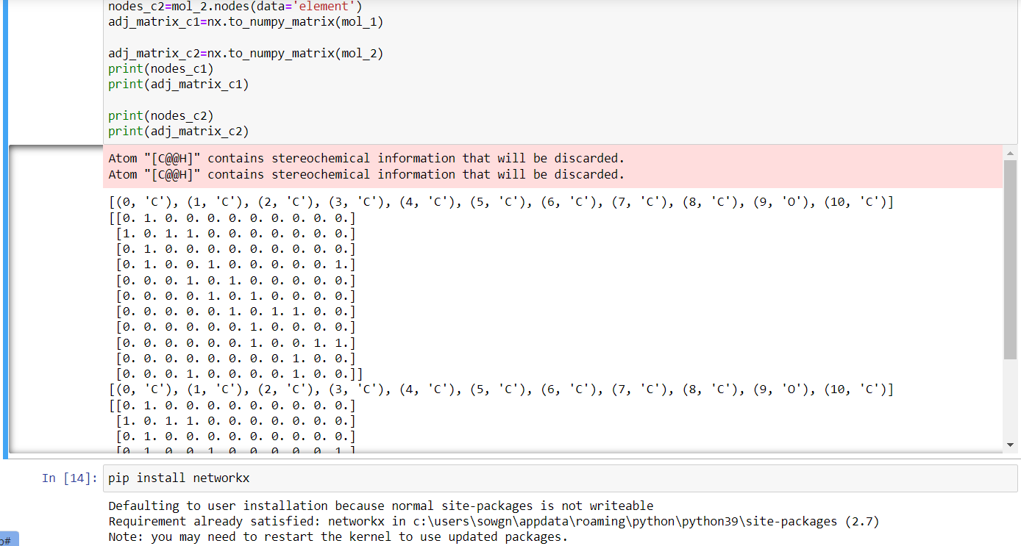

Slide 11
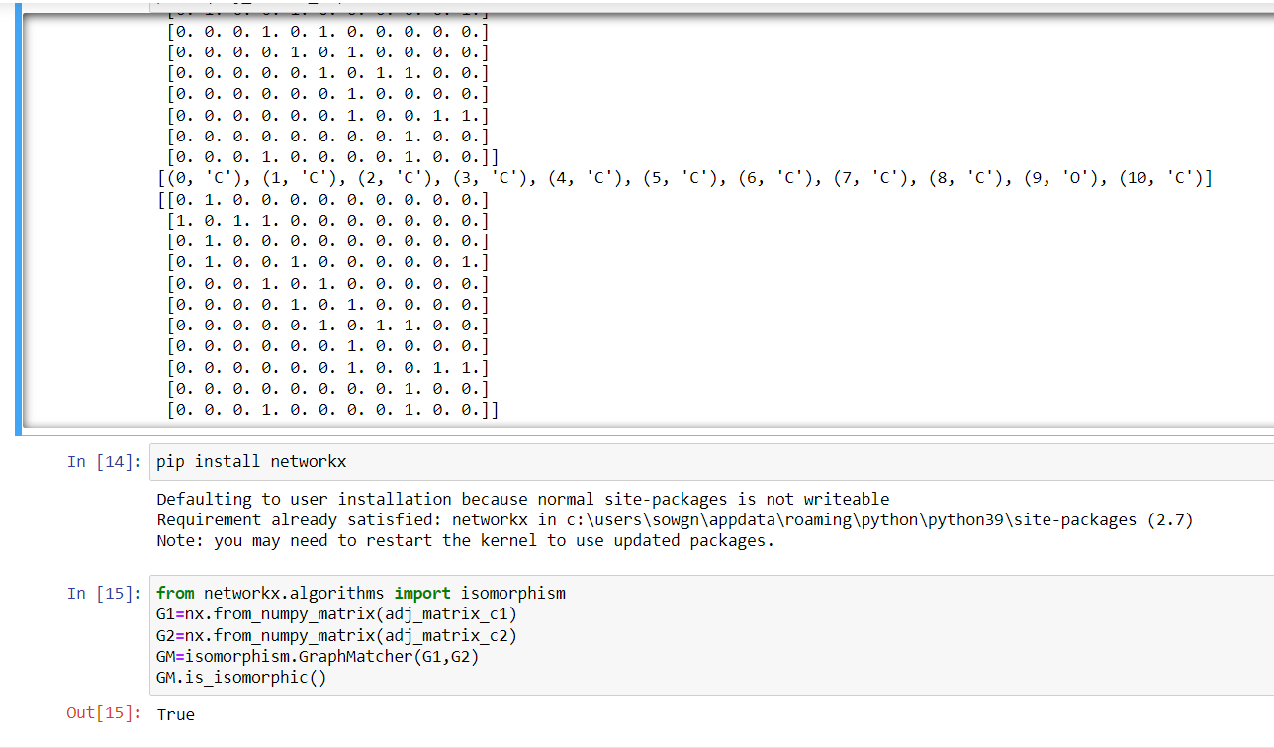

Slide 12
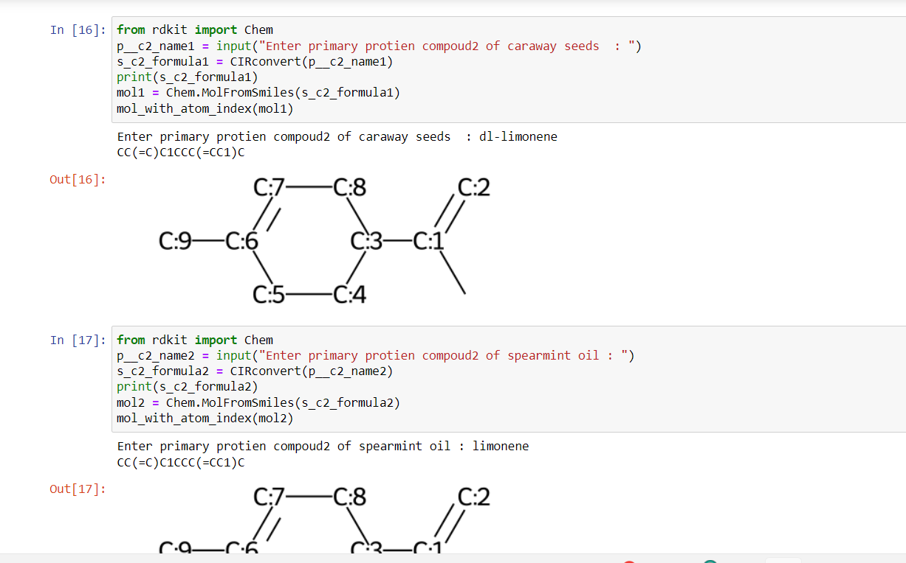

Slide 13
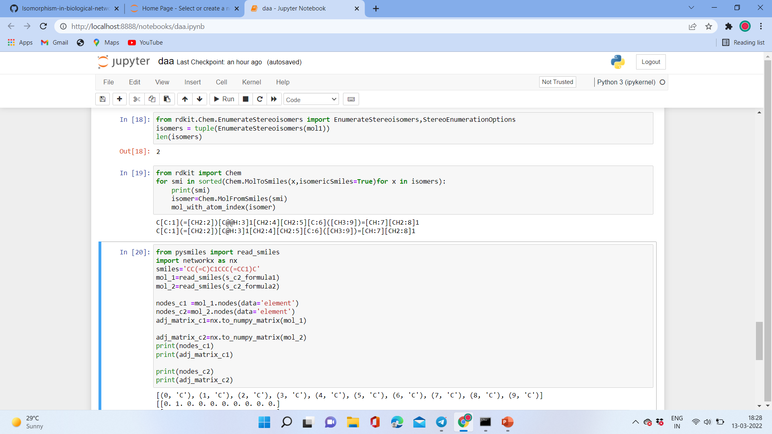

Slide 14
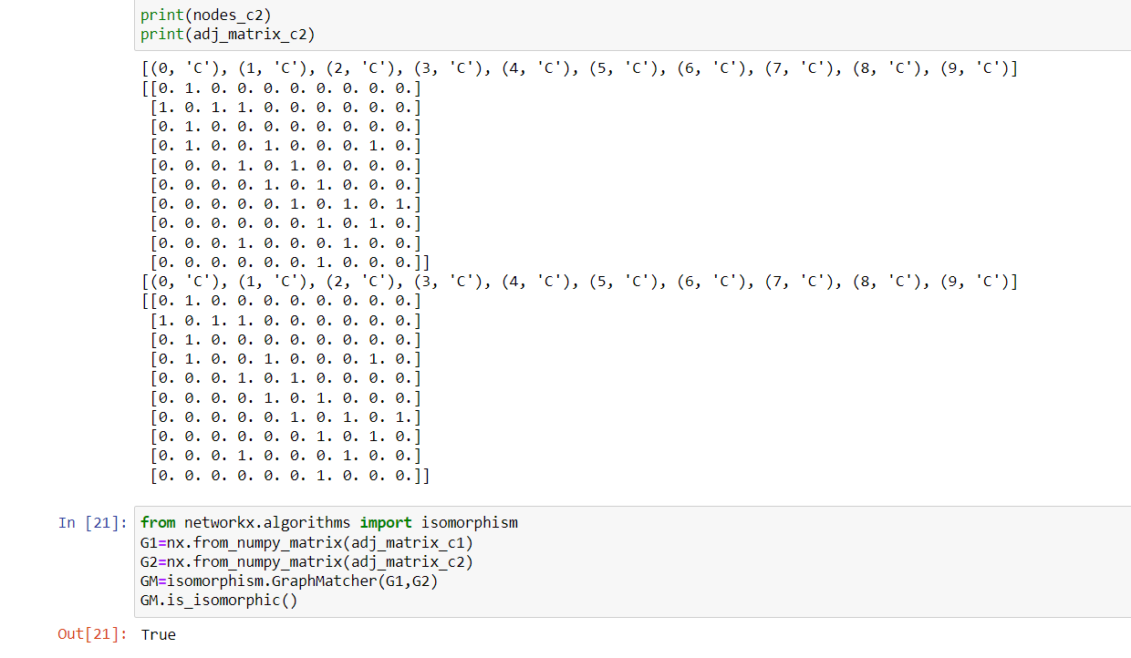

Slide 15
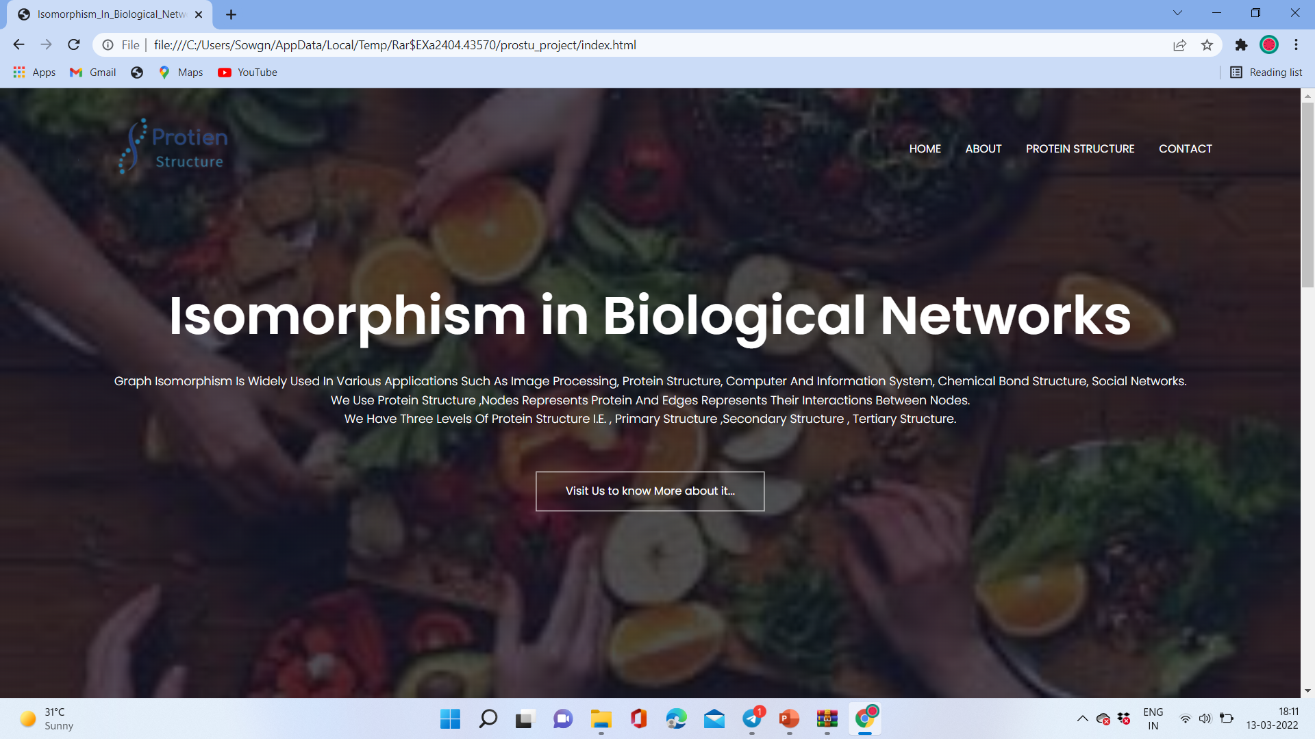
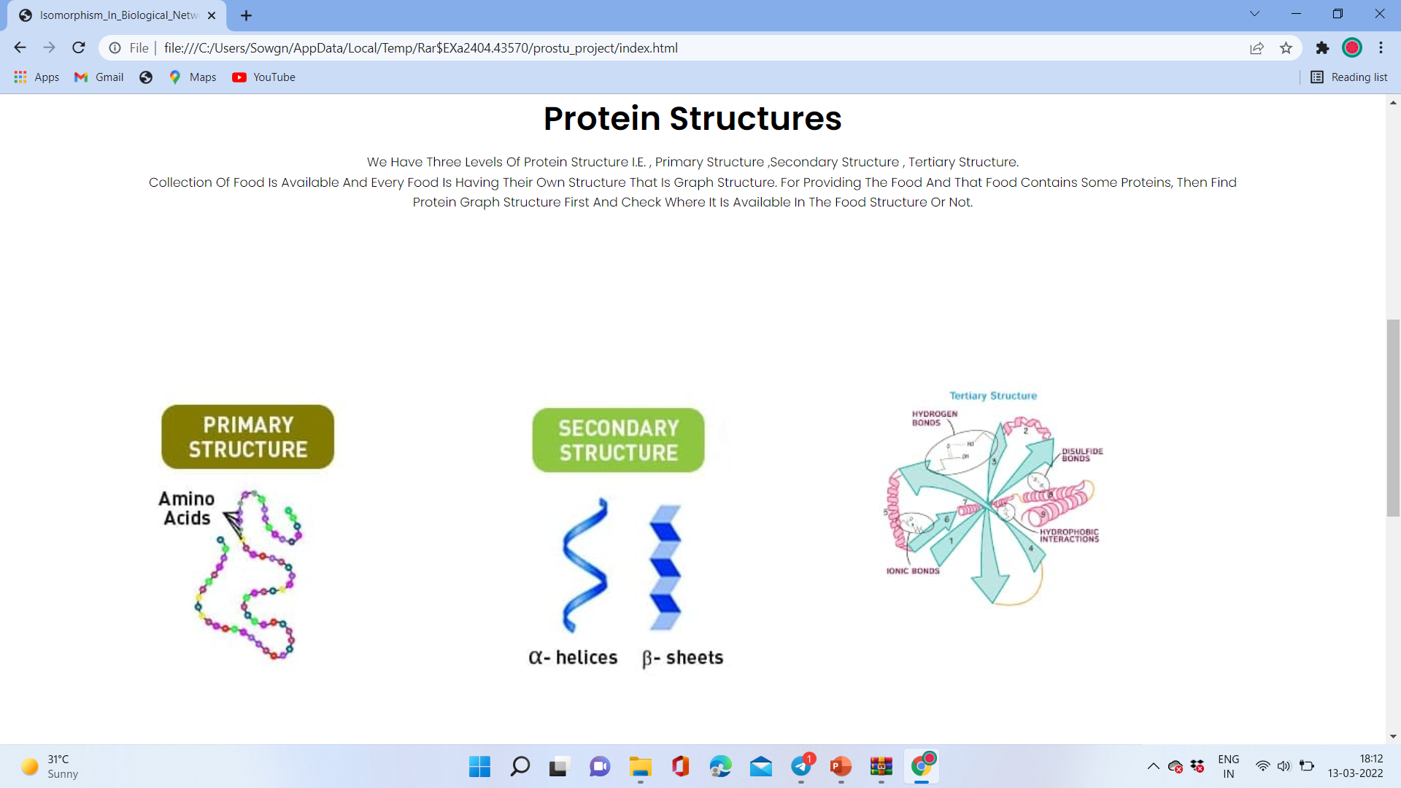
Front End

Slide 16
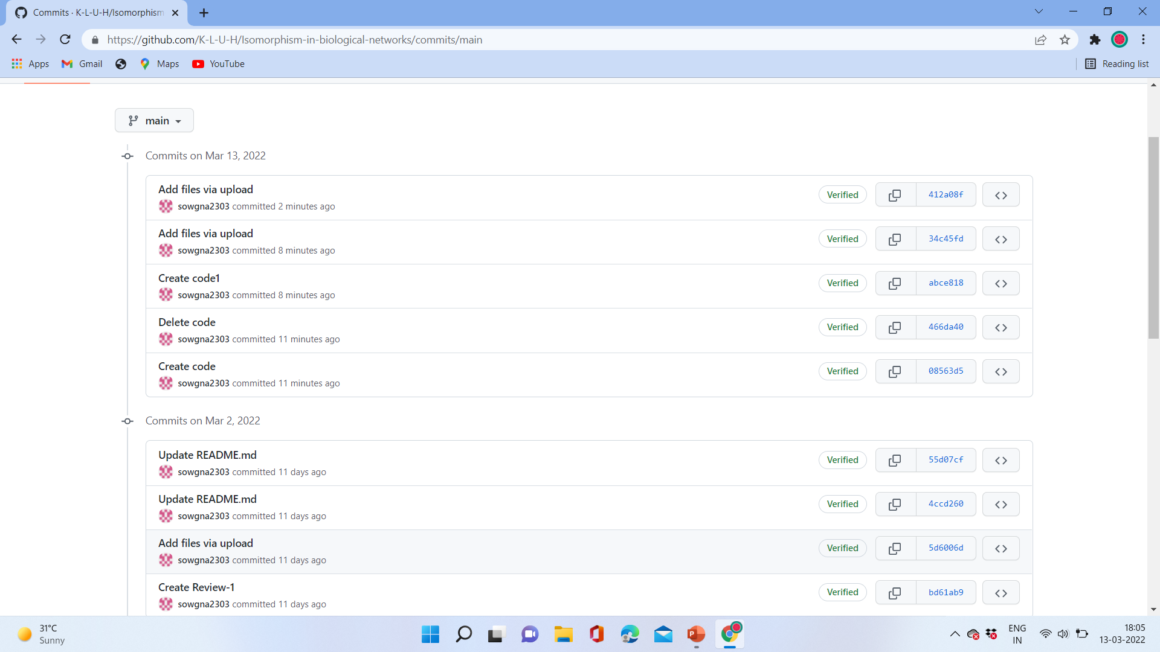
Github commits(16 commits)

Slide 17
Division of work among the group members
N. Sowgna- Coding testing, ppt
E. Pravallika ,Tahseen Begum-Algorithm used- its description- Numeric example of the algorithm (Sample input - expected output)
Keerthana –Flow Chart

Slide 18

THANK YOU

